Slide 1

How to Install Git on Mac
Howard University, Washington, DC
Department of Mathematics
Moussa Doumbia, Ph.D.

Slide 2
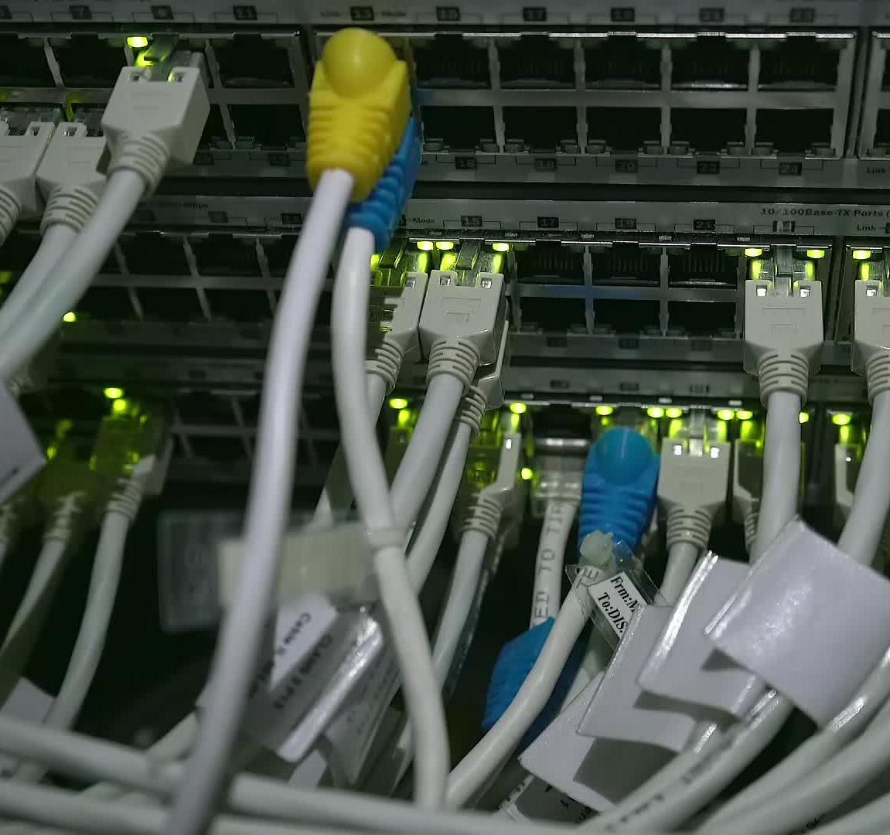
Step 1: Downloading Git Installer
1. Open your web browser and go to https://git-scm.com/download/mac.
2. Click on the macOS installer link to download the Git installer for Mac.

Slide 3

Step 2: Installing Git
Locate
Choose the “Binary installer” Locate the downloaded installer (usually in your 'Downloads' folder) and double-click it.
Click
If prompted, click 'Continue' to proceed with the installation.
Review
Review the License Agreement and click 'Continue,' then click 'Agree' to accept the terms.
Choose
Choose the destination for the installation and click 'Install.'

Slide 4
Step 3: Completing the Installation
1. The installation process may take a few minutes.
2. Once the installation is finished, click 'Close' to complete the setup.

Slide 5

Step 4: Verifying Git Installation
1. Open the Terminal application on your Mac.
2. Type 'git --version' and press Enter.
3. If Git is installed correctly, the version number should be displayed.
4. Congratulations! Git is now installed on your Mac and ready to use.

